Slide 1
Rail Safety Worker
Engineering and Design Competency
30/08/17

Slide 2
Background
MTM has regulatory obligations and accreditation requirements to ensure that Rail Safety Workers (RSW) are competent for the tasks they are completing.
Currently, RSW performing ‘Engineering & Design’ rail safety work must comply with the ‘Business Rules Manual for the Contracting Rail Safety Worker’ (L0-HMRMAN-001).
Signalling has a mature process for management of Engineering and Design RSW using a Statement of Competence to provide transparency of individuals competence.
Other disciplines have a “high level” system that was appropriate at the time, but no longer provides sufficient clarity around individuals level of railway specific competency, especially with the influx of new RSW.

Slide 3
Identifying and of Competency
MTM are introducing a “Statement of Competency” for the following disciplines:
    Electrical Networks (Power Engineering and Overhead)
    Track and Civil
    Structures
    Building Services
    Architectural
    Rolling Stock (Electrical, Mechanical, Communictations)
These will provide additional clarity to MTM and help fulfill its regulatory and accreditation requirements.

Slide 4
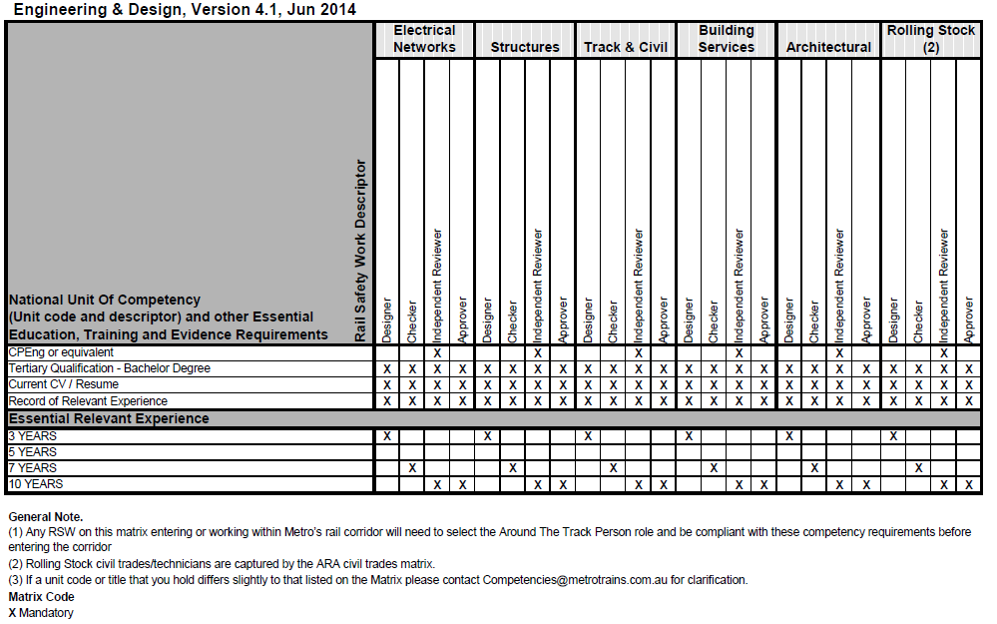
Assessment of Competence (Existing)
Evidence of Tertiary Qualifications
  Qualifications depend on role.
  Overseas qualifications recognised (Washington Accord or Sydney Accord)
Current Resume
  Record of relevant experience
  Compulsory minimum years of relevant experience required
Reviewed every 4 years (most are due now due to RRL)
Don’t have adequate transparency. For example, can’t tell difference between OHW and Substation Designer, or Track Designer and Drainage Designer, etc.

Slide 5
Assessment of Competence (Proposed)
Evidence of Tertiary Qualifications and CV same as existing
Statement of Competence now required
    Demonstrate relevant experience in line with discipline specific role descriptions
    “Element of confidence” based on ARTC assessment (a.k.a. skills)

Slide 6
Assessment of Competence (Proposed)
Technical and Leadership Competencies
Element of Competence Description | Designer Level | Checker level | Approver Level
Interpret and scope design requirements including design drawings. | Undertstands requirements of discipline specific standards and project Funtional Requirements and can apply to the design process. | Evaluates and reviews discipline specific design scope requirements and identifies any gaps, or recommends changes to Standards/Functional Requirements if appropriate. | Provide consultation, direction and leadership in the design process and capable of approving design scope. Ensures staff have appropriate experience to undertake detailed scoping tasks, defines systems to ensure requirements are addressed.
Understanding the drafting requirements to satisfy the CAD Standard | Follows processes to review the acceptability of submitted DMS drawings in accordance with MTM and PTV Standards. | Evaluates and reviews discipline specific drawings for approval and recommends any dispensations that would be acceptable in accordance with PTV CAD Standards. Identifies existing DMS drawings that need to be revised or superseded. | Provide consultation, direction and leadership in the preparation of Drawing Management Plans, CAD systems, CAD drawings with the capability to approve discipline specific drawings.
Undertake site investigations/ inspections and surveys to ensure base design data is verified. | Identifies requirements for site investigations and surveys, follows processes to capture site investigation information suitable for inclusion on drawings. | Evaluates and reviews discipline specific site investigation information on drawings and arranges approval as the competent employee in the drawing title block. | Provide consultation, direction and leadership in the capture of information for site investigation/surveys.
Ensure designs are compliant with Standards and Functional Requirements. | Completes self check of work, follows defined processes to have work checked/verified, incorporates review comments. | Evaluates and reviews discipline specific design documentation for compliance to standards and Functional Requirements. | Provide consultation, direction and leadership in the preparation of Design Management Plans with appropriate system for ensuring design documentation meets requirements.
Investigate the acceptability of non-conformances and prepare standard waiver submissions | Prepares information pertaining to non-conformances to assess acceptability. | Evaluates and reviews non-conformances against Standards and provides MTM with recommendations for controls. | Provide consultation, direction and leadership in the presentation of standard waivers.
Ensure integration of engineering systems with other professional input | Follows processes to review the integration of railway systems during the design process and within the submitted drawings, identifies where design is dependant on specialist advice/reports (eg geotechnical, bonding). | Identifies and manages interfaces between railway disciplines, evaluates requirements from specialist advice, evaluates and reviews integration of design documentation for acceptance. | Provide consultation, direction and leadership in the integration of railway systems, defines and applies process to ensure interfaces are managed.
Undertake the validation of designs (design checking and independent reviews) | Completes self check of work, follows defined processes to have work checked/verified, incorporates review comments. | Evaluates and reviews discipline specific design documentation for compliance to standards and Functional Requirements, ensures non-conformances are addressed, recommends controls for non-conformances that can't be resolved. | Ensures staff have appropriate experience to undertake checking verification tasks, defines systems for checking/verification of design documentation, documents process in Design Management Plan.
Preparing and maintaining documentation during the design process | Ability to prepare and maintain documentation during the design process in accordance with prescribed quality processes. | Provides direction and leadership to management of design documentation including management of discipline specifc design items (eg computations, design models, specialist reports). | Provide consultation, direction and leadership developing systems for maintaining documentation, developed document process in Design Management Plans with appropriate systems to ensure quality control is effectively managed during the design process.

Slide 7
Assessment of Competence (Proposed)
Benefits for industry include:
  Compulsory minimum years experience now “Recommended,” providing adequate competency levels are demonstrated.
  More flexibility to demonstrate higher level competency (eg a designer with 4 years of relevant experience designing pedestrian crossings may achieve a Checker competency for that area but Designer for other areas)
  Easier for Designers/Checkers who are not “railway” designers to achieve competency in a specific area (eg a Fire Protection Engineer with only building industry experience).

Slide 8
Timeline
New SOC and “Engineering and Design” matrix to go live on Onsite Website and Metro Academy in September 2017.
MTM will issue notification to all Designers, Checkers and Approvers with a MTM Competency.
Designers will have 9 months to provide relevant evidence and get assessed to the new SOC. Most MTM Competencies were issued for Regional Rail Link Project (4 years ago). This re-assessment aligns closely with the timeframe requirements to be re-assessed.

